Slide 1
High temperature materials for gas cooled reactor heat exchanger
NE 795 – Fall 2021.

Slide 2
Outlines
Heat exchanger environment
Concepts of heat exchangers
Candidate materials for high temperature gas cooled reactors

Slide 3
Heat exchanger environment
Very High temperature.
Temperature difference.
Stresses.
Pressure drop.
Chemical potential difference.
Oxidation.

Slide 4
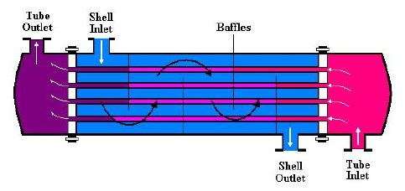
Heat exchanger concepts
Shell and tube heat exchanger.
Most common type.
generally built of a bundle of round tubes mounted in a cylindrical shell with the tube axis parallel to that of the shell.
One fluid flows inside the tubes and the other fluid flows across and along the tubes.
Figure.1. Shell and tube heat exchanger.

Slide 5
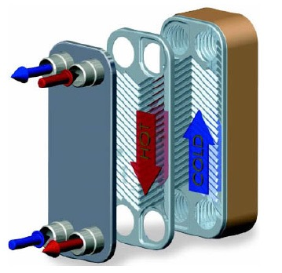
Plate Heat Exchanger
plate or planar surfaces are the fundamental heat transfer surfaces rather than tubes.
consists of a series of thin, corrugated alloy plates sealed and compressed together inside a carbon steel frame.
Figure.2. Plate heat exchanger.

Slide 6
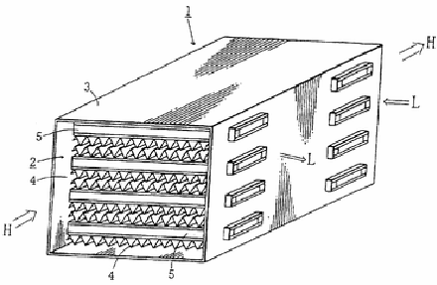
Plate and Fin Heat Exchanger
Plate and fin heat exchangers are formed by stacking flat metal plates alternately with corrugated metal plates (fins).
Heat transfer occurs as hot and cold fluids flow through the fins between alternate flat plates
stainless steel and titanium plate and fin.
Figure.3. Plate and fin heat exchanger

Slide 7
Printed Circuit Heat Exchanger
relatively new concept that has been commercially manufactured by Heatric since 1985.
robust heat exchangers that combine compactness, low pressure drop, high effectiveness, and the ability to operate with a very large pressure differential between hot and cold sides
manufactured by the same technique used to produce standard printed circuit boards for electronic equipment.
the risk of leaks in a Heatric heat exchanger is approximately two orders of magnitude lower than for any other heat exchanger.
flexibility of allowed fluid types

Slide 8
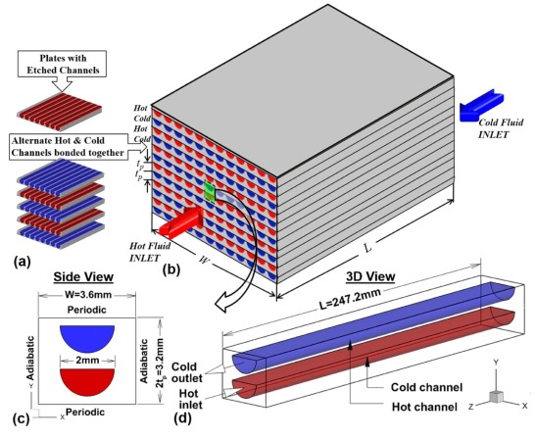
Figure.4. printed circuit heat exchanger.

Slide 9
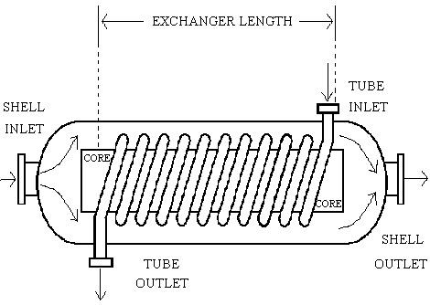
Helical Coil Heat Exchanger
consist of tubes spirally wound into bundles and fitted in a shell.
The spiral geometry of the tubes results in a higher heat transfer.
used for gas-liquid heat transfer applications, primarily when the operating temperature and/or pressure are very high.
Cleaning a helical coil heat exchanger can be very difficult.
Figure.5. Helical coil heat exchanger.

Slide 10
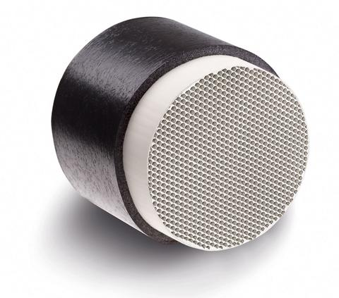
Ceramic Heat Exchanger
ceramic material properties. Silicon carbide (SiC) ceramics are the leading choice for heat exchangers because they are ideally suited for high temperature, corrosive environments.
ceramics are able to operate safely at higher temperatures (~1300oC) than metallic alloys
However, leakage between the primary and intermediate fluids can be a significant issue if the pressure difference between the fluids is large.
SiC can be susceptible to oxidation at high temperatures.
The mechanical properties of SiC material are dependent on factors such as porosity and the impurity concentration.
Figure.6. Ceramic heat exchanger

Slide 11

Figure.8. selection criteria of heat exchangers.

Slide 12
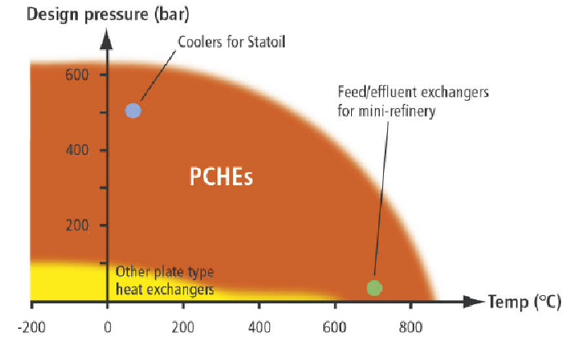
Figure.7. Allowable ranges for heat exchangers.

Slide 13
High temperature materials.
The candidate materials.
Alloy 617
Alloy 230
Alloy HX
Incoloy Alloy 800HT
Alloy 800H
Alloy 625
Alloy HR160
Alloy 556
Potential Materials.
Alloys 617, 230, HX, 800H, and 800HT.
Notes:
Selection mechanical properties
physical properties
environmental resistance, fabrication and joining

Slide 14
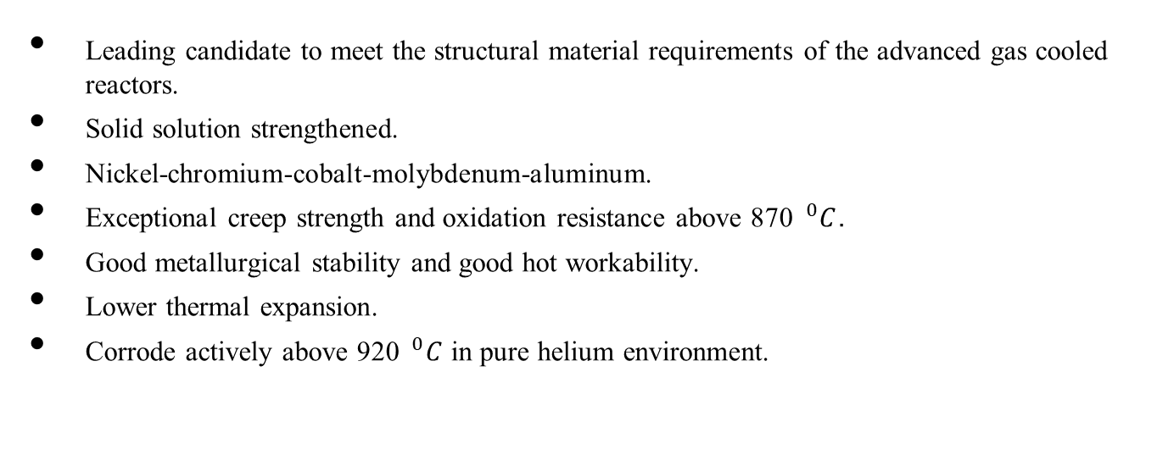
Alloy 617
Leading candidate to meet the structural material requirements of the advanced gas cooled reactors.
Solid solution strengthened.
Nickel-chromium-cobalt-molybdenum-aluminum.
Exceptional creep strength and oxidation resistance above 870 $^{0}C$.
Good metallurgical stability and good hot workability.
Lower thermal expansion.
Corrode actively above 920 $^{0}C$ in pure helium environment.

Slide 15
Alloy 230
Very recently developed alloy.
Solid solution strengthened.
Nickel-chromium-tungsten-molybdenum.
High temperature strength.
Resistance to oxidation environment.
Good hot workability and weldability.
lower thermal expansion.

Slide 16
Alloys 800H/HT
Iron-base solid solution strengthened alloy.
Large addition of nickel and chromium.
800HT and 800H have nearly identical chemical composition except of C, Al, Ti.
Solution annealed at high temperatures.

Slide 17
Alloys Hastelloy X
Nickel-chromium-iron-molybdenum alloy.
Moderated strength at higher temperatures.
Good oxidation resistance.
Compatible with impure helium environment.

Slide 18
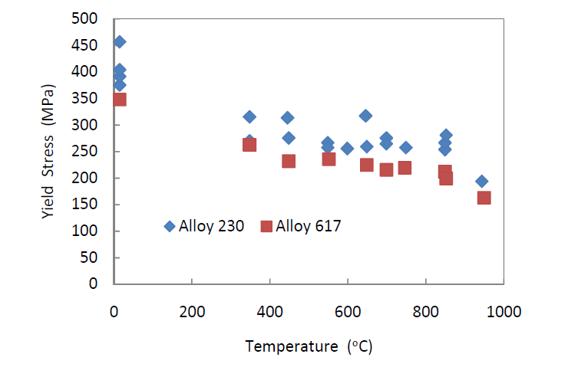
Figure.8. Yield strength of the as received alloys 617 and 230.

Slide 19
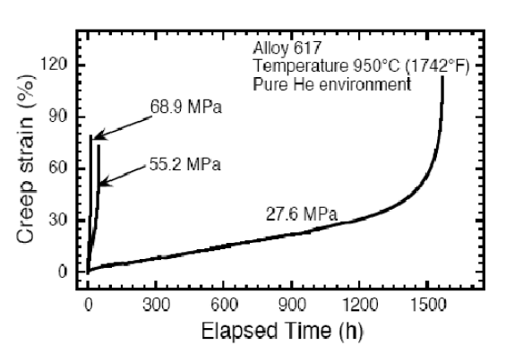
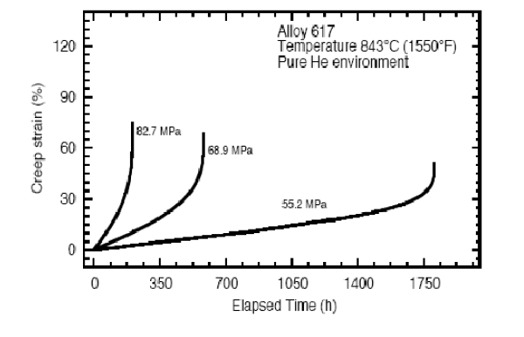
Creep of Alloy 617
Figure.9. creep of alloy 617 at two different temperatures.

Slide 20
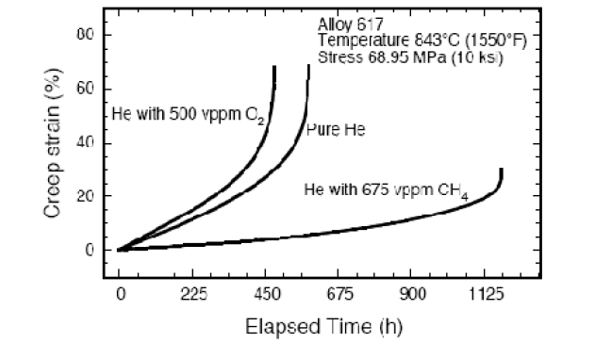
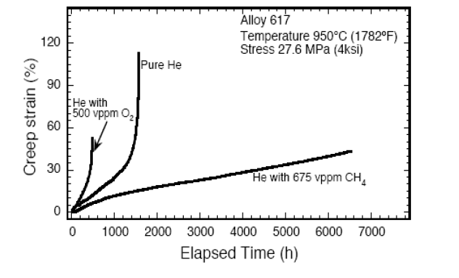
Effect of methane and oxygen impurities in helium on the creep of Alloy 617
Figure.10. creep of alloy 617 at two different temperatures and environments.

Slide 21
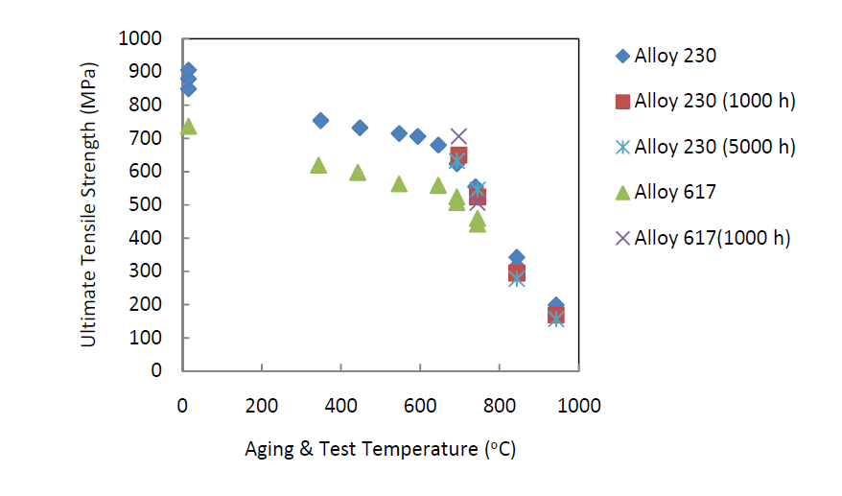
Thermal aging and thermal stability
Figure.11. creep of alloy 617 at two different temperatures.

Slide 22
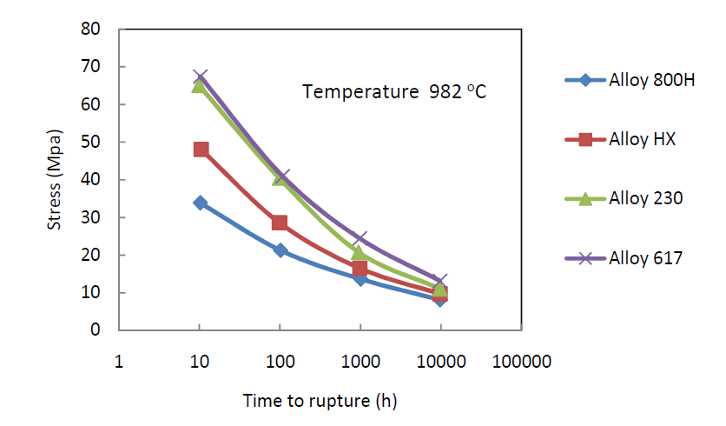
Comparison between creep strength for different candidates.
Figure.12. Creep rupture strength of different candidate materials.

Slide 23
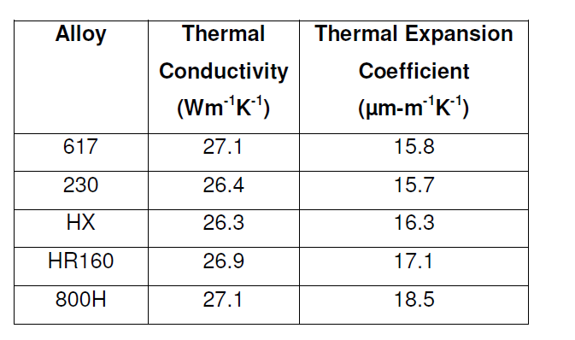
Physical Properties
Table.1. Thermal Conductivity and mean thermal expansion for various candidate materials at $900 ^{0}C$.

Slide 24

Questions.

Slide 25
